Slide 1
MAP STREAM INITIALIZING WHAT-IF ANALYSES FOR REAL-TIME SYMBIOTIC TRAFFIC SIMULATIONS.
Abhinav Sunderrajan, Heiko Aydt, Wentong Cai and Alois Knoll
Presented by:Yadong Xu

Slide 2
Agenda
Background and motivation
Map-matching for real time traffic state estimation
Map matching problem
Map matching over a data stream
Optimizations for latency reduction
Results
Future work and conclusions
Notes:
30s

Slide 3
Agenda
Background and motivation
Map-matching for real time traffic state estimation
Map matching problem
Map matching over a data stream
Optimizations for latency reduction
Results
Future work and conclusions

Slide 4
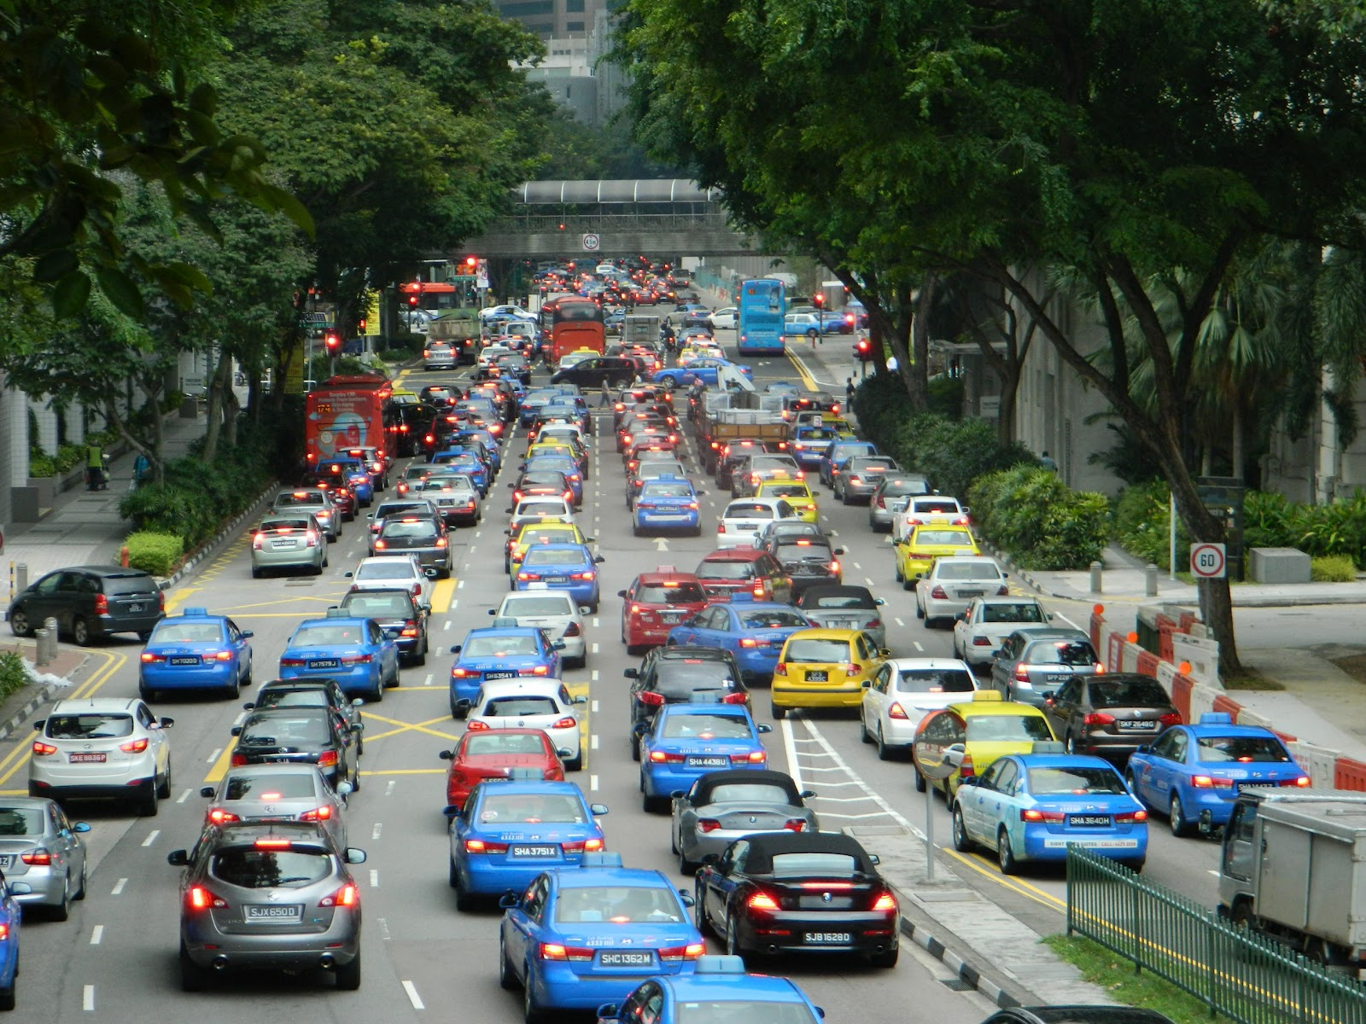
Background and Motivation
Taxis and busses equipped with GPS.
Anonymized users seeking route guidance from in car navigation systems
GPS accuracy has improved from 15m in the past to about 3m to 5m today.
Notes:
A lot gps data available nowadays.

Slide 5
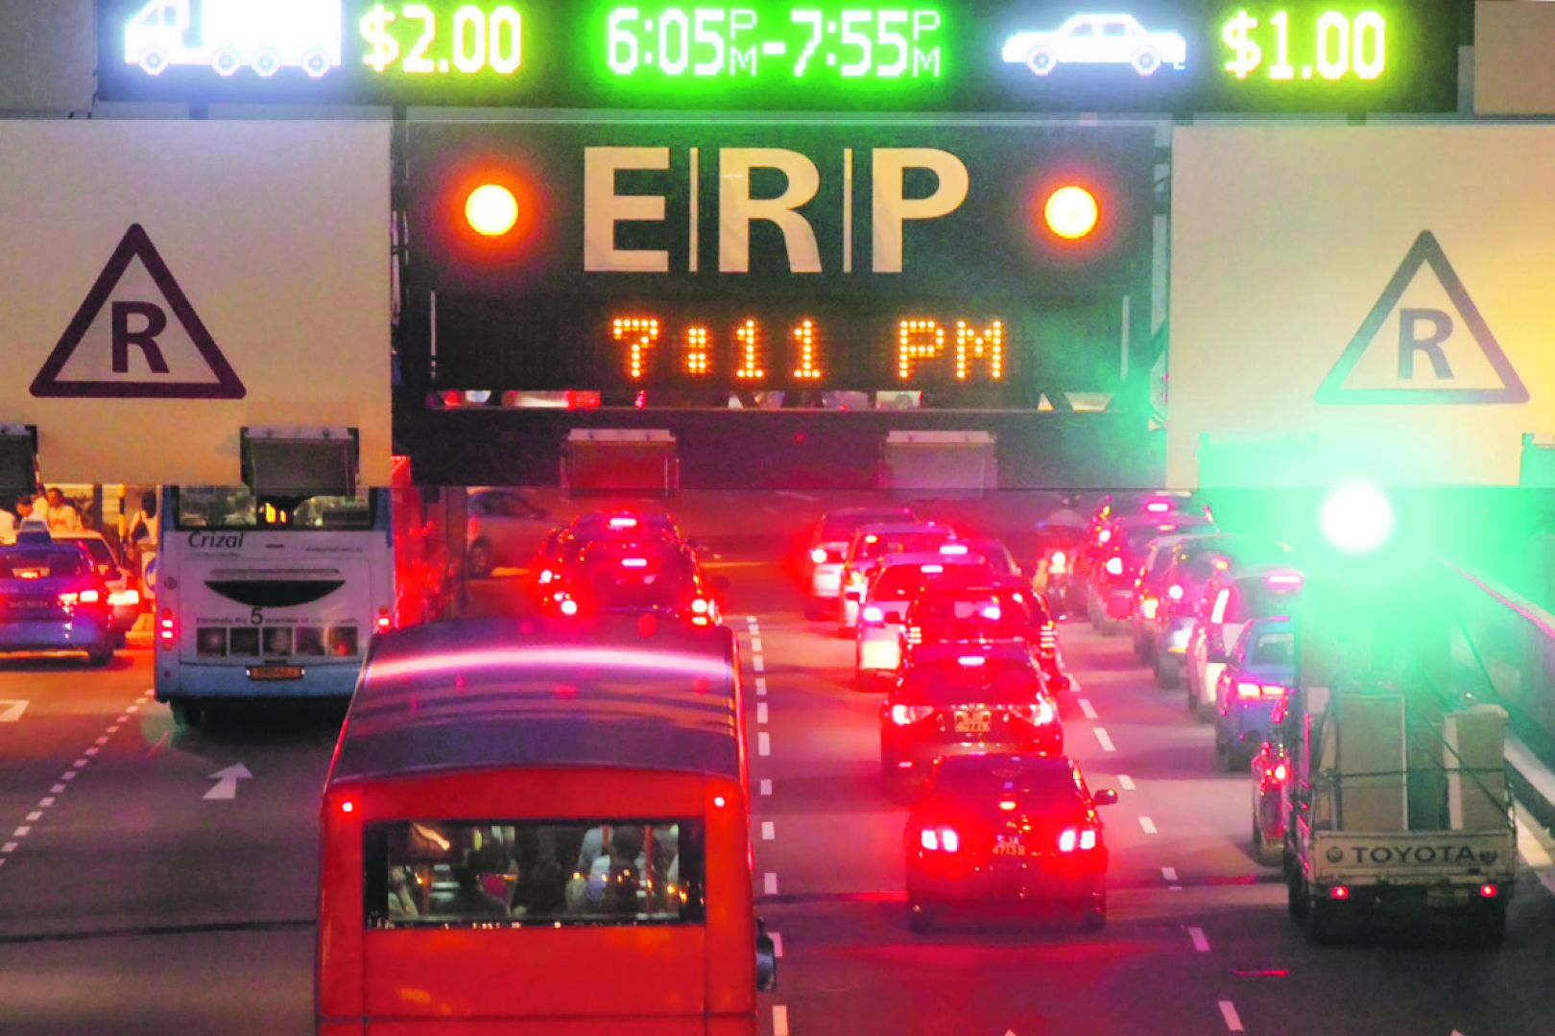
Background and Motivation
Next generation ERP could be Global navigation satellite system based.
Thus most vehicles will have GPS receivers emitting data such as location and speed at fixed time intervals.
Notes:
Singapore ERP2.0 2020 in plan.

Slide 6
Background and Motivation
Given the sheer number of vehicles on the entire road network of a city, the location of vehicles is obtained in the form of an unbounded, continuous data-stream.
However due to inaccuracies associated with GPS data suitable map-matching algorithms need to be employed.
We present and evaluate a scalable algorithm which can be used to map the position of several vehicles from a data-stream on to a digital road network using sliding windows.
A symbiotic traffic-simulation could be initialized by using the GPS location information provided by the vehicles
Notes:
3min

Slide 7
Agenda
Background and motivation
Map-matching for real time traffic state estimation
Map matching problem
Map matching over a data stream
Optimizations for latency reduction
Results
Next steps in Symbiotic traffic simulation

Slide 8
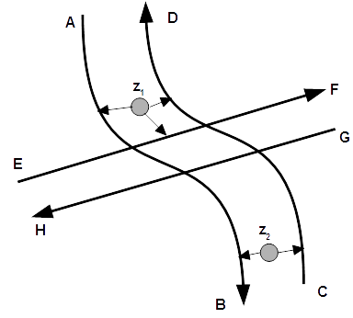
Map matching problem
Map-matching algorithms have been used to map noisy GPS data on to a digital road network.
Due to inherent noise there is always some uncertainty with associating a GPS sample with a road.
Geometric map-matching algorithms make use of the shape of the roads and (or) the trajectory of the vehicles on the roads. Topological map-matching algorithms. consider the road connectivity and contiguity along with geometric features.
Advanced techniques such as Kalman Filters have also been effectively used for map-matching.
Most of the existing works treat map-matching as a batch task are thus unsuitable for a high-volume GPS data stream.
Notes:
Uncertainty in Z1 & Z2, with the two tgt, we can guess the most likely route the vehicle takes.
They don’t focus on latency, but accuracy.

Slide 9
Map matching problem
Given the streaming nature of the GPS probe data it is critical that the map-matching algorithm is not only reliable but also able to compute the results with minimal latency.
We use a Hidden Markov Model(HMM) based algorithm for map matching. HMM is used to model a process with hidden states using the observed states.
Notes:
1.5 min - 5min until now.

Slide 10
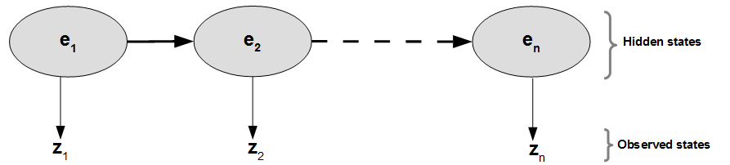
Hidden Markov Model (HMM) for map matching
The noisy GPS data point or the observed state of the HMM at time t is represented by z_{t} ϵ Z.
Each z_{t} is a tuple containing latitude, longitude, speed, vehicle-id and time-stamp information as fields.
A hidden state of the HMM represents the actual position of a vehicle on an edge e_{t} ϵ E at time t on the road network graph G(V,E).

Slide 11
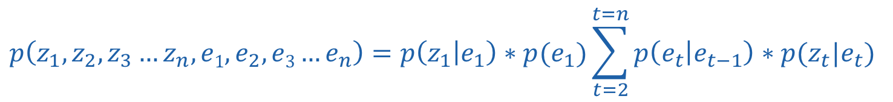
HMM formula
$$p\left(z_{1},z_{2},z_{3}…z_{n},e1,e_{2},e3…e_{n}\right)=p\left(z_{1} | e_{1}\right)∗p(e_{1})\sum_{t=2}^{t=n}{p\left(e_{t} | e_{t−1}\right)∗p(z_{t}|e_{t})}$$
Initial distribution
Transition probabilities
Emission probabilities
Notes:
Joint probability distribution.

Slide 12
HMM for map matching
Emission probabilities p(z_{t} |e_{t}) represents the probability of a noisy GPS data point z_{t} being associated with an edge e_{t} ϵ E.
Transition probabilities p(e_{t} |e_{t-1}),represent the probability that a vehicle travels to edge e_{t} given that it was on e_{t-1}.
Notes:
1.5 minutes 7 minutes until now

Slide 13
Map matching over a data stream
Sliding window length=2
z_{v1}
z_{v2}
z_{v3}
z_{v4}
z_{v5}
z_{v6}
z_{vt} is a tuple representing the geo location and speed of vehicle v at time t
For implementing a real-time, on-line map-matching algorithm, the GPS signals belonging to a single vehicle are thus added to a sliding length window of size 2.
The joint probability distribution corresponding to the HMM thus reduces to computing only two states, i.e., e_{t-1} to e_{t} corresponding to z_{vt-1} to z_{vt} .
Notes:
Window size is 2, to keep the latency low and not burden the system.

Slide 14
Map matching over a data stream
Sliding window length=2
z_{v1}
z_{v2}
z_{v3}
z_{v4}
z_{v5}
z_{v6}
z_{vt} is a tuple representing the geo location and speed of vehicle v at time t
For implementing a real-time, on-line map-matching algorithm, the GPS signals belonging to a single vehicle are thus added to a sliding length window of size 2.
The joint probability distribution corresponding to the HMM thus reduces to computing only two states, i.e., e_{t-1} to e_{t} corresponding to z_{vt-1} to z_{vt} .

Slide 15
Map matching over a data stream
Sliding window length=2
z_{v1}
z_{v2}
z_{v3}
z_{v4}
z_{v5}
z_{v6}
z_{vt} is a tuple representing the geo location and speed of vehicle v at time t
For implementing a real-time, on-line map-matching algorithm, the GPS signals belonging to a single vehicle are thus added to a sliding length window of size 2.
The joint probability distribution corresponding to the HMM thus reduces to computing only two states, i.e., e_{t-1} to e_{t} corresponding to z_{vt-1} to z_{vt} .

Slide 16
Map matching over a data stream
Sliding window length=2
z_{v1}
z_{v2}
z_{v3}
z_{v4}
z_{v5}
z_{v6}
z_{vt} is a tuple representing the geo location and speed of vehicle v at time t
For implementing a real-time, on-line map-matching algorithm, the GPS signals belonging to a single vehicle are thus added to a sliding length window of size 2.
The joint probability distribution corresponding to the HMM thus reduces to computing only two states, i.e., e_{t-1} to e_{t} corresponding to z_{vt-1} to z_{vt} .
Notes:
1 minute. 8 minutes until here

Slide 17
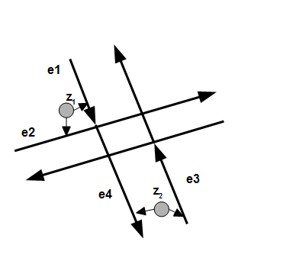
Computing emission and transition probabilities
Consider an example where two successive, noisy GPS signals z₁, z₂ from a single vehicle could be associated with edges e₁ or e₂ and e₃ or e₄ respectively.
The probability of the most likely route taken by the vehicle p_{route} is given by
$$proute=max⁡\left\{p\left(z1,z2,e1,e3\right),p\left(z1,z2,e1,e4\right),p\left(z1,z2,e2,e3\right),p(z1,z2,e2,e4)\right\}$$
Notes:
4 combinations.

Slide 18
Computing emission and transition probabilities
Assuming that p(e_{t}), i.e., the probability of a vehicle being on any of the roads in the proximity of the GPS sample is the same and expanding the terms we get
$$proute=max⁡\{p(z1|e1)∗ p(e3|e1)∗ p(z2|e3), p(z1|e1)∗ p(e4|e1)∗ p(z2|e4),$$
$$p(z1|e2)∗ p(e3|e2)∗ p(z2|e3), (p\left(z1 | e2\right)∗ p\left(e4 | e2\right)∗ p\left(z2 | e4\right)\}$$

Slide 19
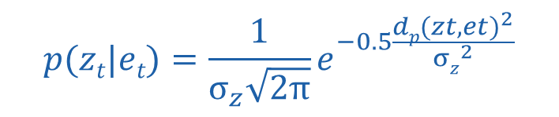
Computing emission and transition probabilities
Assuming a Gaussian noise with standard deviation of σ_{z} meters, the emission probabilities for each of the edges e_{t} associated with a given GPS measurement z_{t} is given by
$$p(zt|et)=\frac{1}{σ_{z}\sqrt{2π}}e^{−0.5\frac{{dp(zt,et)}^{2}}{{σz}^{2}}}$$
where d_{p}(z_{t} , e_{t}) represents the perpendicular distance from the GPS sample z_{t} to edge e_{t} .
Notes:
1 minute for emission probability 9 minutes total

Slide 20
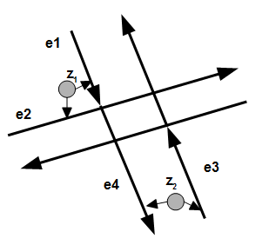

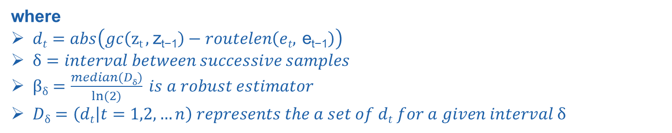
Computing emission and transition probabilities
Transition probabilities p(e_{t}|e_{t-1}) is computed using the below formula
$$\text{p}\text{(}e\text{t}\text{|}\text{e}\text{t}\text{−1}\text{)}=\frac{1}{βδ}e^{−\frac{dt}{βδ}}$$
where
$dt=abs\left(gc\left(\text{z}\text{t}\text{ , }\text{z}\text{t}\text{−1}\right)−routelen\left(et, \text{e}\text{t}\text{−1}\right)\right)$
$δ=interval between successive samples$
$βδ=\frac{median(Dδ)}{ln⁡(2)} is a robust estimator$
$Dδ=\left(dt | t=1,2,…n\right) represents the a set of dt for a given interval δ$
gc(z₁, z₂) is a function returning the great circle distance between two GPS coordinates z₁ and z₂
routelen(e₁,e₂) computes the shortest route from edge e₁ to edge e₂ where e₁, e₂ ϵ E
Notes:
No need to go into the details here.

Slide 21
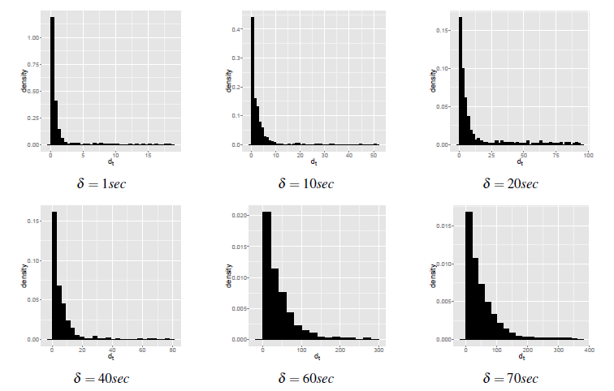
Probability density of d_{t} at different intervals δ
Probability density of d_{t} at different sampling intervals
Notes:
Transition probability explain 10 minutes total.

Slide 22
Optimizations for latency reduction
Real time map-matching over a GPS data stream needs to focus on keeping computational latency as low as possible while maintaining a fair degree of accuracy.
Evaluating the several route alternatives to compute the transition probabilities is costly.
The task of finding the closest edges to GPS data point is also time consuming if we consider all the edges in the road network.
A solution for reducing the search space is necessary.

Slide 23
Optimizations for latency reduction
Recursively split the network into four quadrants till number of nodes within a quadrant is equal to a below a predefined value. The cap I have used is 50.

Slide 24
Optimizations for latency reduction
Reduce the latency in terms of finding the closest edges to a given GPS point by restricting the search space to the leaf node the GPS point falls into.
Road-network is preprocessed to create an edge-partition(s) mapping. An edge is associated with a partition if it is part of a shortest path leading to the partition.
While computing the shortest paths from a vertex belonging to one partition to another vertex belonging to a different partition, only those edges leading to the destination partition are considered.
Notes:
2 minutes for latency optimizations. 12 minutes total.
- Dijkstra in Transition
- Emission

Slide 25
Agenda
Background and motivation
Map-matching for real time traffic state estimation
Map matching problem
Map matching over a data stream
Optimizations for latency reduction
Results
Future work and conclusions

Slide 26
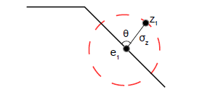
Experimental setup
A synthetic GPS data stream at different sampling intervals and with varying Gaussian noise was generated for performing the experimental analysis owing to the lack of vehicle trajectory data.
For generating a GPS stream at a given sampling frequency of δ seconds, we make use of the speed range information available for all edges constituting the road network. Given a speed range of S_{i1} m/s to S_{i2} m/s for an edge e_{i}, the distance traveled by the vehicle before emitting the next GPS location signal is taken to be S_{i2}*δ meters.
The steps are repeated for 50 randomly chosen routes at different sampling frequencies.
Once the noise free GPS signals are created for 50 routes at different sampling frequencies, we add Gaussian noise of zero mean and varying standard deviation of σ_{z} meters at random angle θ between 0 and 360 from the original location.
Shifted GPS point due to Gaussian noise.
Notes:
1 minute for this slide 11 miutes total

Slide 27
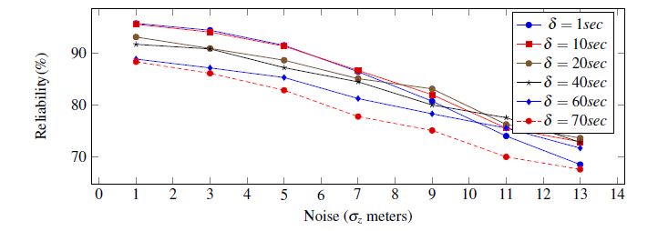
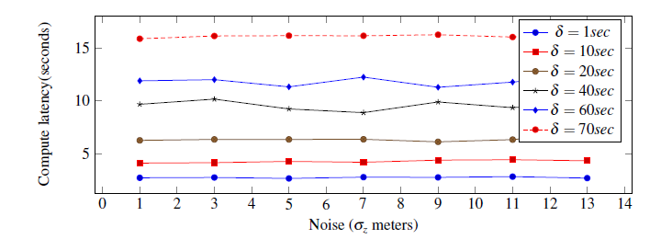
Results
Noise vs sampling interval vs reliability
Noise vs sampling interval vs compute latency
Notes:
Noise increase, reliability decrease
Interval increases, reliability decreases
Interval increases, latency increases (dijkstra takes longer time)
Latency does not depend on noise.
Road network topology also has a great influence on the result.
2 minutes for results. Total 14 minutes.

Slide 28
Agenda
Background and motivation
Map-matching for real time traffic state estimation
Map matching problem
Map matching over a data stream
Optimizations for latency reduction
Evaluation
Future work and conclusions

Slide 29

Future work
DISTRIBUTED DATA STREAM PROCESSING ENGINE
M₁
R₁
Number of vehicles on a road segment.
Average velocity of vehicles on a road segment.
Count of distinct vehicles on a road segment over an hour.
High volume data stream
M₂
R₂
Vehicle id, lat, lon, speed, time
M₃
R₃
Vehicle id, road segment, speed, time
M_{n}
R_{n}
MAPPERS
REDUCERS
Current per road macroscopic quantities
Notes:
Real-time map-reduce
1 minute this slide – 15 minutes total.

Slide 30


Symbiotic traffic simulation
High volume data stream
Short term prognosis
User anonymized data about the vehicle to the backend to asses the current traffic condition.
Multi-agent simulation
Advances in multi real-time speed (For short term prognosis)
What if analyses
Distributed data stream processing engine for map matching and state estimate
Emulator
(Advances in real time)
Events such as accidents
Current traffic state
Notes:
(1.5 minutes) 16 minutes total

Slide 31
Conclusions
An online map-matching solution which can be used to match the location of several vehicles from a continuous data stream has been presented.
The results indicate that the accuracy of map-matching was in the range of 85% to 92% when interval between successive GPS data points from a single vehicle was in the range of 10 seconds to 40 seconds and standard deviation of noise was in the range of 5 meters to 9 meters.
Map matching allows extraction and continuous update of macroscopic quantities such flow, density and average velocity of road segments constituting the road-network.
Online map matching presented here is the first step towards a city-scale symbiotic traffic simulation by providing means to retrieve continuous information from the physical system i.e. the road network of a city.
Notes:
1 min conclusion. Total 17.5-18 minutes.

Slide 32
Thank you for your attention! Questions?

